Slide 1
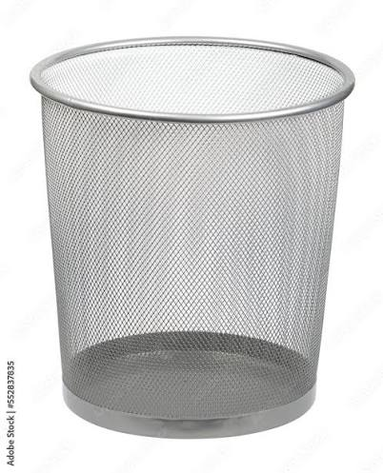
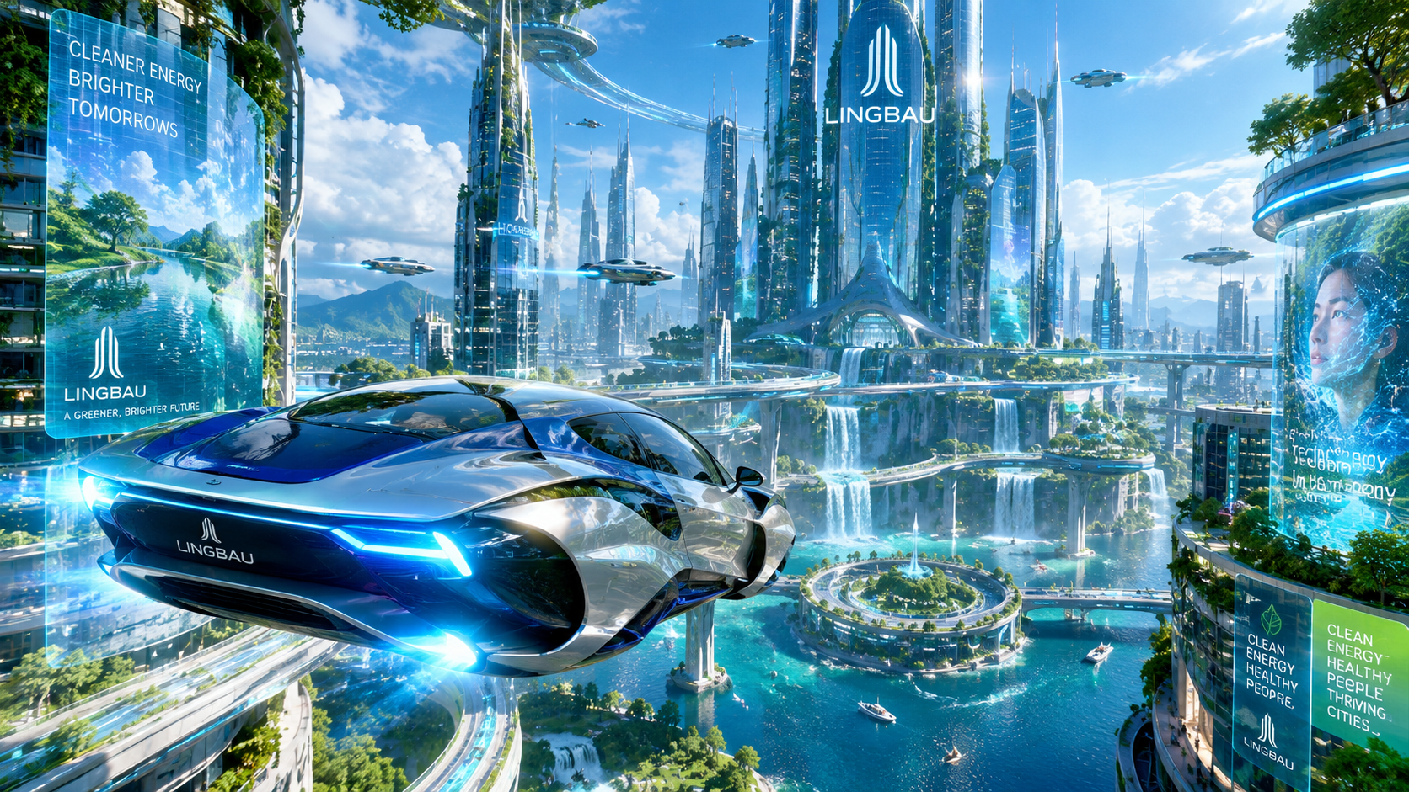
Welcome to Arasaka City
By Daniil

Slide 2
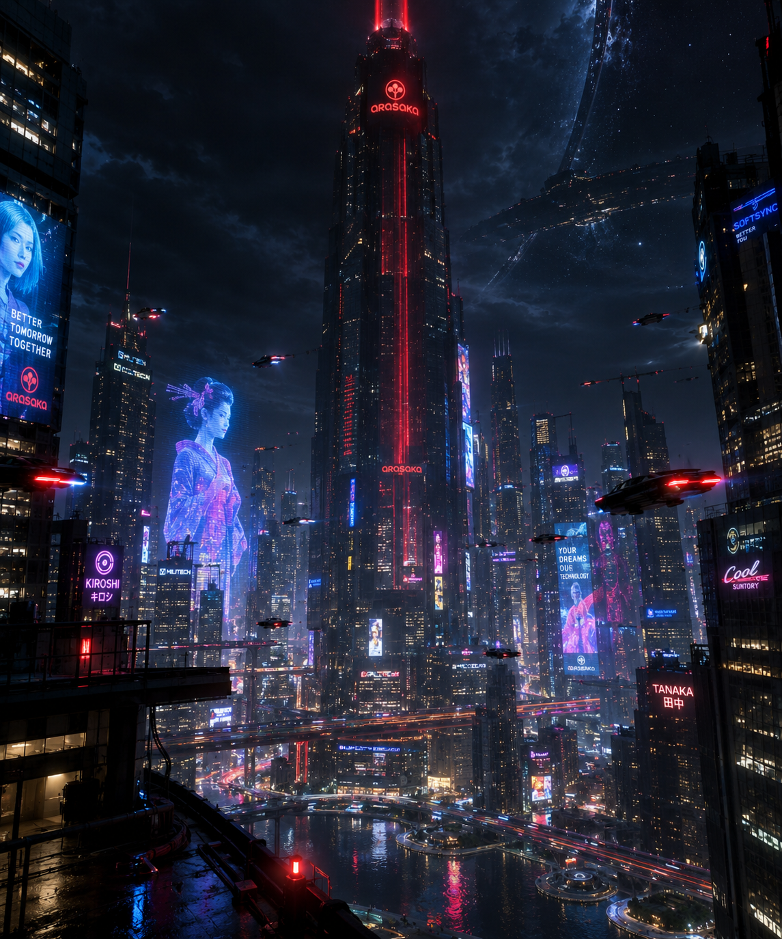
The big Problem
The problem in Arasaka city is that there are too much gangs. Its basically Oblock but in the future, the main gang that controls most of the drugs, guns and military equipment is names Ragnorock.

Slide 3
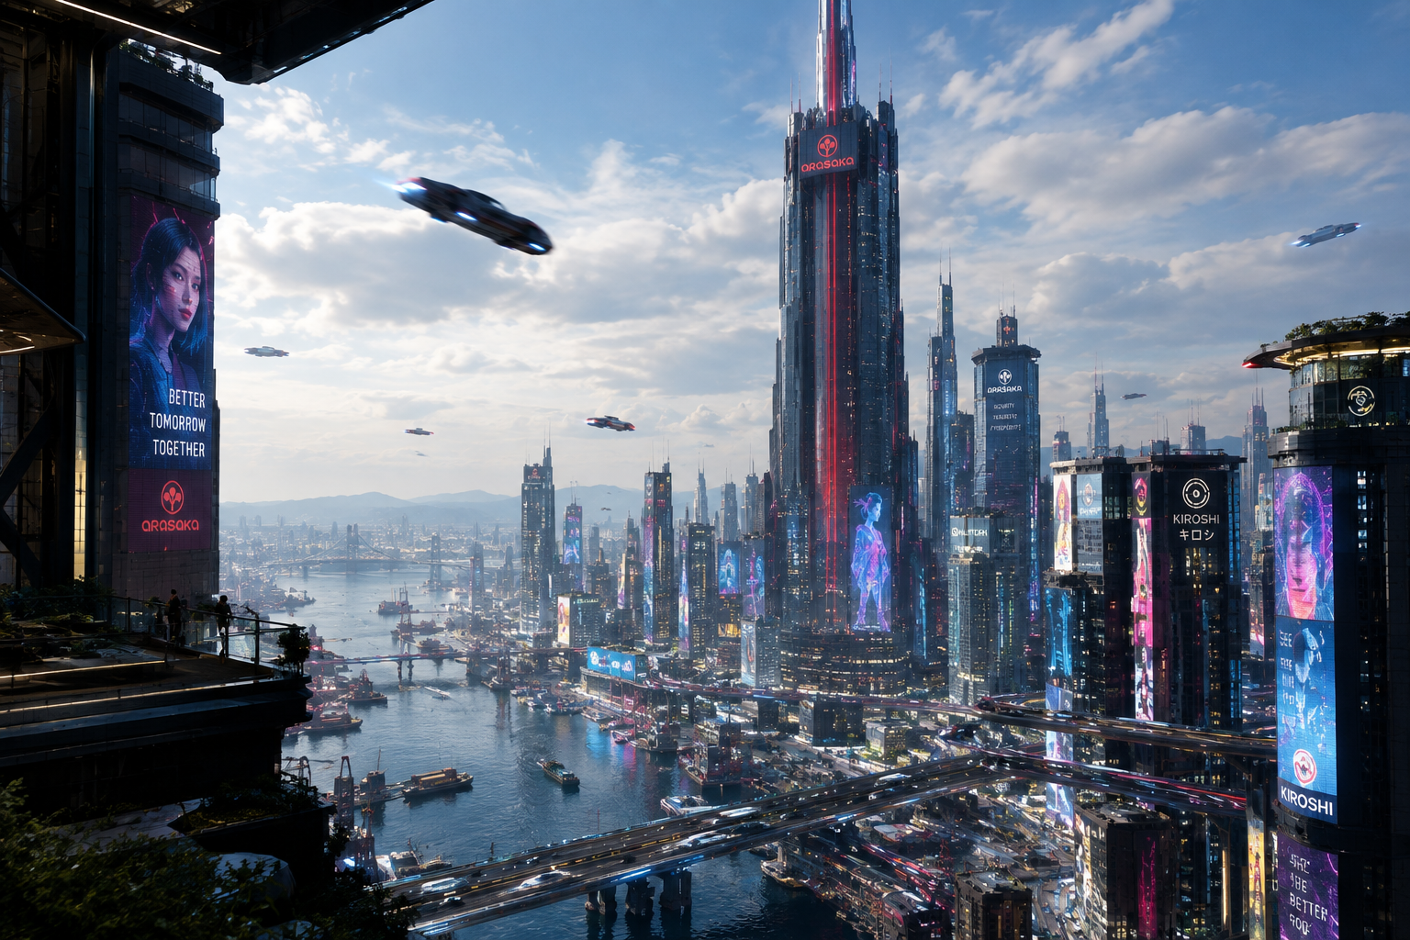
Meet the city
The city was originally first build in 2032 were over the 45 years it has developed to the biggest city on the planet. Its funded by the biggest corporations on earth and moon. The prime minister of the city is Juan Federico Jamon.
Image of him.---)

Slide 4
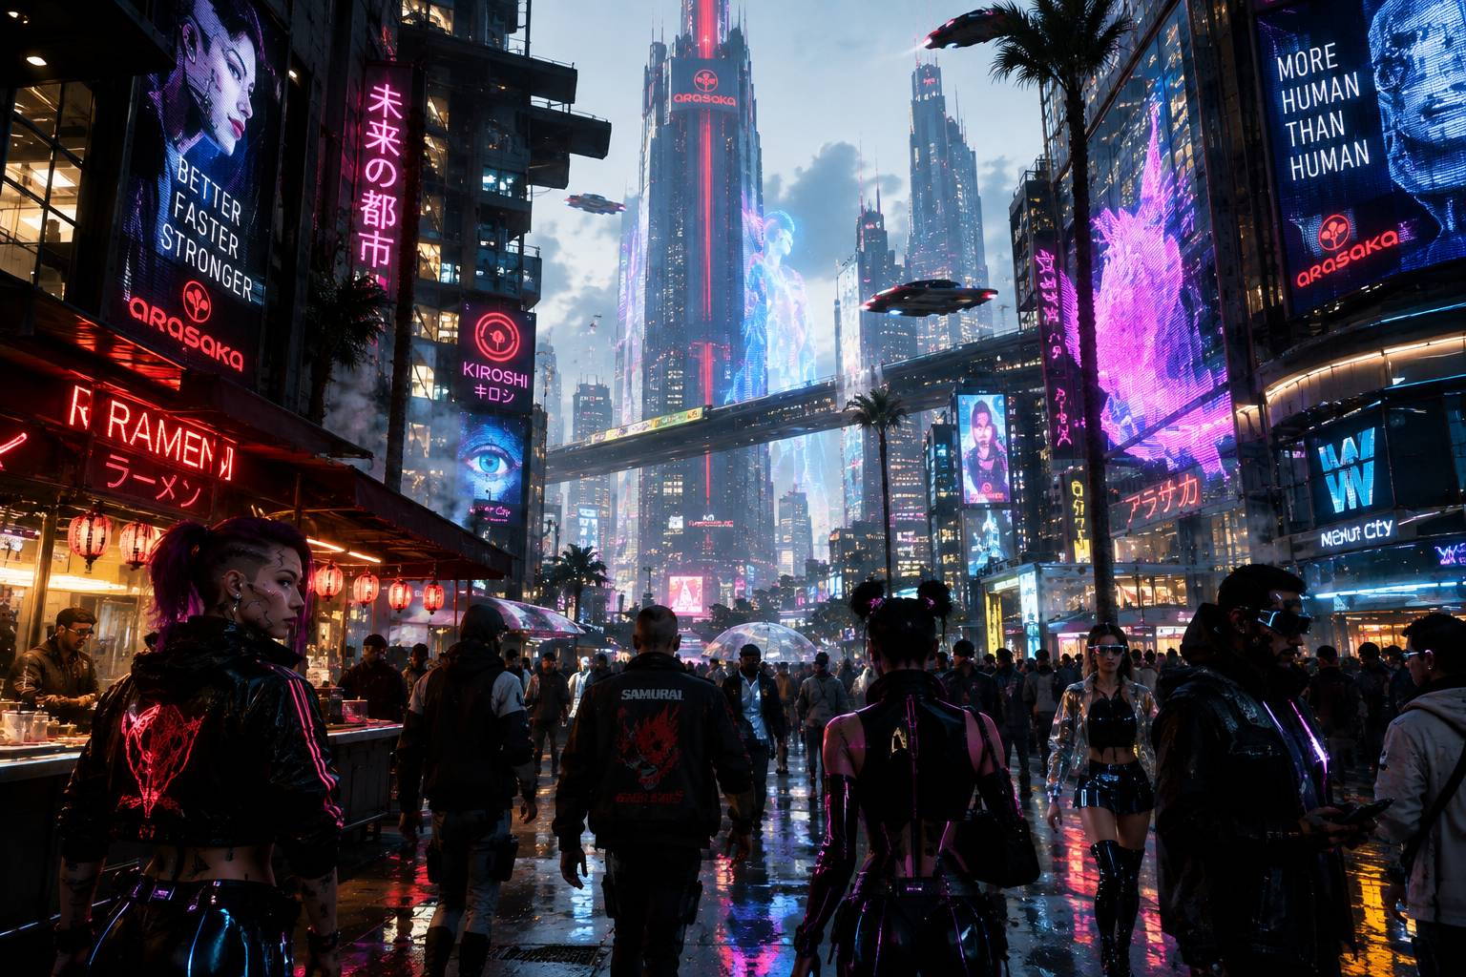
The population
Arasaka is one of the fastest growing citys on earth and has even surpassed LingBau in population back in 2049.

Slide 5
A day in life in Arasaka
As a 14 year old the city streets are clean but very busy all day. It alright living in arasaka the schools are really good and I love the food places. Also a lot of places to hang out with my friends.

Slide 6
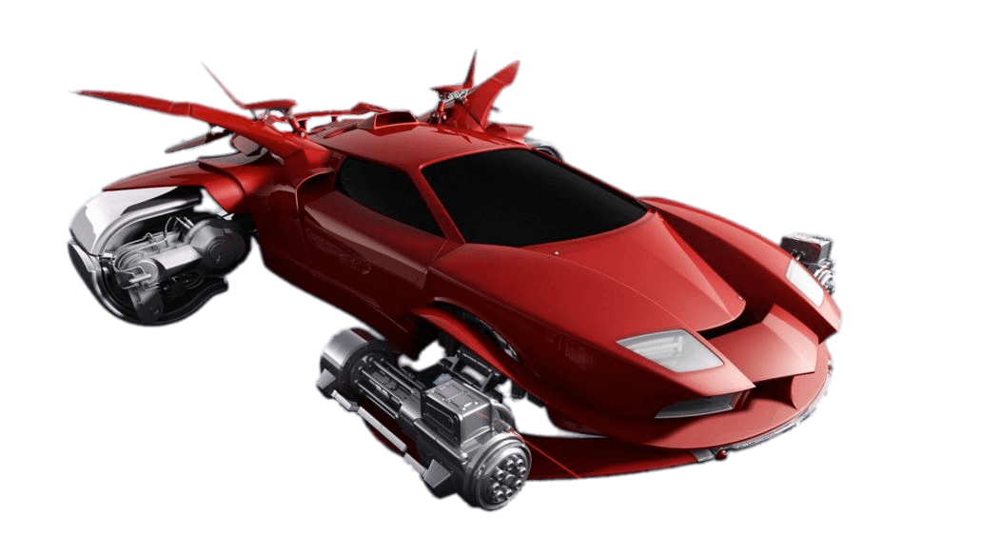
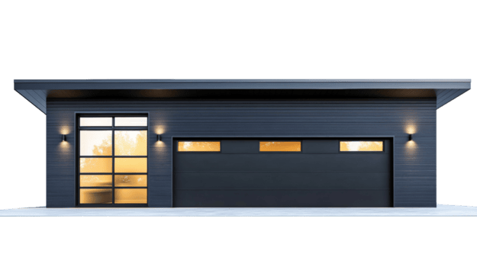
Why should you come?
Arasaka is the most developed city in the world.
Everyday millions of good things happen in it and who knows you might do one of the good things. Arasaka is also widley known for its fantastic transport around the massive city and the cars, no cars are allowed in Arasaka only flying cars are allowed so if you want to trael in it you better buy a flying car or a yearly subway subscription. Also taxes are very cheap here because of how eco friendly the city is and an apartment costs less than a car!

